Slide 1

DEI Strategy at CISCRP
By
Adarsh Prajapat
Khushi Khushi
Henry Lee
Nicolas Marin

Slide 2



What is DEI?
Diversity
Equity
Inclusion
Competitor Analysis
Competitor Analysis
Methods and Key Findings
Methods and Key Findings
Strategic Alternatives
Strategic Alternatives
Strategic Recommendations
Background and Aims
Recommendations and Implementation
Background and Aims
Notes:
https://www.google.com/url?sa=i&url=https%3A%2F%2Fwww.linkedin.com%2Fpulse%2Fcreating-tapestry-success-power-diversity-inclusion-corporate-vij&psig=AOvVaw2OwlRhSr9kr0KpZyyXHPpI&ust=1714274412873000&source=images&cd=vfe&opi=89978449&ved=0CBIQjRxqFwoTCNDx2I244YUDFQAAAAAdAAAAABAJ
https://www.google.com/url?sa=i&url=https%3A%2F%2Fwww.planning.org%2Fknowledgebase%2Fequity%2F&psig=AOvVaw1zXoqFoINUeIWx1h_tB_bJ&ust=1714274485796000&source=images&cd=vfe&opi=89978449&ved=0CBIQjRxqFwoTCPCllqG44YUDFQAAAAAdAAAAABAP
https://www.google.com/url?sa=i&url=https%3A%2F%2Fdiversitymbamagazine.com%2Fdiversity-inclusion%2F20-types-of-inclusion-to-consider-for-a-truly-inclusive-workplace%2F&psig=AOvVaw0JEKMngGKd7gi7brW7-tH7&ust=1714274561438000&source=images&cd=vfe&opi=89978449&ved=0CBIQjRxqFwoTCMir2Mi44YUDFQAAAAAdAAAAABAE

Slide 3






Who is CISCRP?
Education
Collaboration
Tackling Barriers
Trust
Optimize Health
Competitor Analysis
Competitor Analysis
Competitor Analysis
Methods and Key Findings
Methods and Key Findings
Methods and Key Findings
Strategic Alternatives
Strategic Alternatives
Strategic Alternatives
Strategic Recommendations
Strategic Recommendations
Background and Aims
Recommendations and Implementation
Background and Aims
Background and Aims

Slide 4




Products and Services
Health Communications
Scientific Research
Content Licensing
Events
Competitor Analysis
Competitor Analysis
Competitor Analysis
Methods and Key Findings
Methods and Key Findings
Methods and Key Findings
Strategic Alternatives
Strategic Alternatives
Strategic Alternatives
Strategic Recommendations
Strategic Recommendations
Background and Aims
Recommendations and Implementation
Background and Aims
Background and Aims

Slide 5
Market and Service Area
United States
China
Europe
Japan
Competitor Analysis
Competitor Analysis
Competitor Analysis
Methods and Key Findings
Methods and Key Findings
Methods and Key Findings
Strategic Alternatives
Strategic Alternatives
Strategic Alternatives
Strategic Recommendations
Strategic Recommendations
Background and Aims
Recommendations and Implementation
Background and Aims
Background and Aims

Slide 6





Problems and Aims
Racial and Ethnic Representation
Age and Generational Diversity
DEI Policies and Practices
Communication
DEI Education and Awareness
Competitor Analysis
Competitor Analysis
Competitor Analysis
Methods and Key Findings
Methods and Key Findings
Methods and Key Findings
Strategic Alternatives
Strategic Alternatives
Strategic Alternatives
Strategic Recommendations
Strategic Recommendations
Background and Aims
Recommendations and Implementation
Background and Aims
Background and Aims

Slide 7
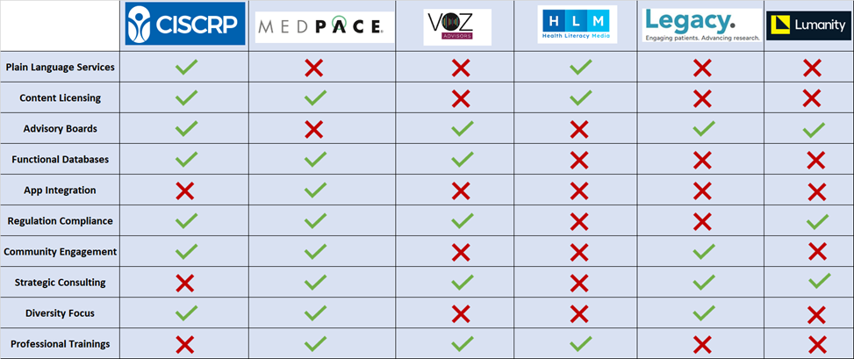
Competitor Analysis by Product Offerings
Competitor Analysis
Competitor Analysis
Competitor Analysis
Methods and Key Findings
Methods and Key Findings
Methods and Key Findings
Strategic Alternatives
Strategic Alternatives
Strategic Alternatives
Strategic Recommendations
Strategic Recommendations
Background and Aims
Recommendations and Implementation
Background and Aims
Background and Aims

Slide 8
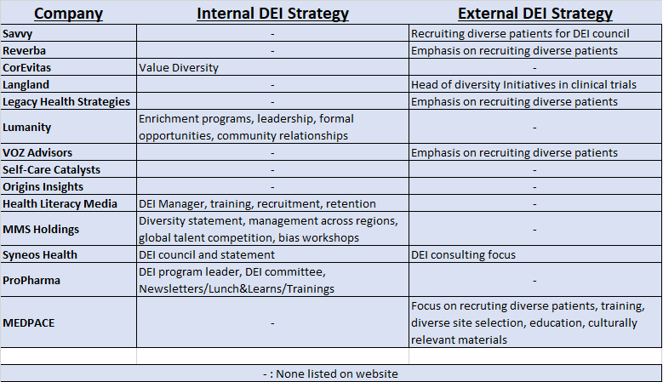
Competitor Analysis by DEI Initiatives
Competitor Analysis
Competitor Analysis
Competitor Analysis
Competitor Analysis
Methods and Key Findings
Methods and Key Findings
Methods and Key Findings
Methods and Key Findings
Strategic Alternatives
Strategic Alternatives
Strategic Alternatives
Strategic Alternatives
Strategic Recommendations
Strategic Recommendations
Strategic Recommendations
Background and Aims
Recommendations and Implementation
Background and Aims
Background and Aims
Background and Aims

Slide 9


Methods
Literature Review
Best practices
Competitor Strategies
Interviews
DEI Leaders
CISCRP Employees
Competitor Analysis
Competitor Analysis
Competitor Analysis
Competitor Analysis
Methods and Key Findings
Methods and Key Findings
Methods and Key Findings
Methods and Key Findings
Strategic Alternatives
Strategic Alternatives
Strategic Alternatives
Strategic Alternatives
Strategic Recommendations
Strategic Recommendations
Strategic Recommendations
Background and Aims
Recommendations and Implementation
Background and Aims
Background and Aims
Background and Aims
Notes:
https://www.google.com/url?sa=i&url=https%3A%2F%2Fwww.iconfinder.com%2Ficons%2F7479650%2Fliterature_literature_review_search_find_read_book_education_icon&psig=AOvVaw1vJiHCwLnebzhkfNDI7eVx&ust=1714273699255000&source=images&cd=vfe&opi=89978449&ved=0CBIQjRxqFwoTCKDFtqi14YUDFQAAAAAdAAAAABAE
https://www.google.com/url?sa=i&url=https%3A%2F%2Fwww.businessnewsdaily.com%2F5836-top-interviewing-skills.html&psig=AOvVaw0Uvhey9IGibw40ulRjBALt&ust=1714273768990000&source=images&cd=vfe&opi=89978449&ved=0CBIQjRxqFwoTCJjvr8u14YUDFQAAAAAdAAAAABAQ

Slide 10
Key Findings from Literature Review
Why is DEI important?
Justice
Creativity
Productivity
Retention
What works?
Clear goals
Measurable efforts
Dedicated resources
Policy review
KPIs
Hiring
Attrition
Promotion
Inclusion
What fails?
Lack of resources
Lack of focus
DEI as an endpoint
Competitor Analysis
Competitor Analysis
Competitor Analysis
Methods and Key Findings
Methods and Key Findings
Methods and Key Findings
Methods and Key Findings
Strategic Alternatives
Strategic Alternatives
Strategic Alternatives
Strategic Alternatives
Strategic Recommendations
Strategic Recommendations
Strategic Recommendations
Background and Aims
Recommendations and Implementation
Background and Aims
Background and Aims
Background and Aims

Slide 11
Key findings from Interviews
DEI Leaders
Takeaways
Importance of Focus
Measurement
Community Buy-In
Representation
Cultural Competency and Humility
CISCRP Employees
Strengths
Positive Culture
Buy-In from Leadership
Financial Resources
Interest in KPIs
Barriers
Remote and In-Person Gap
Size Limitations
Competitor Analysis
Competitor Analysis
Competitor Analysis
Methods and Key Findings
Methods and Key Findings
Methods and Key Findings
Methods and Key Findings
Strategic Alternatives
Strategic Alternatives
Strategic Alternatives
Strategic Alternatives
Strategic Recommendations
Strategic Recommendations
Strategic Recommendations
Background and Aims
Recommendations and Implementation
Background and Aims
Background and Aims
Background and Aims

Slide 12





Strategic DEI Alternatives
Impact Timeframe
Evaluation criteria for strategic alternatives
Cost/Resources Required
Hypothetical Outcome/Impact
Competitor Analysis
Methods and Key Findings
Methods and Key Findings
Strategic Alternatives
Strategic Alternatives
Strategic Recommendations
Background and Aims
Recommendations and Implementation
Background and Aims

Slide 13

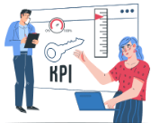

Engaging Employees & Monitoring Progress
1. Engage Whole Organization in DEI Efforts
2. Formal Monitoring Process of KPIs
Formal Monitoring Process of KPIs:
Transition from a top down approach to a more inclusive model.
Implement regular DEI workshops- lunch and learns, feedback sessions, and inclusive decision-making.
Challenges: Handling the inclusion of remote employees and accommodating diverse perspectives.
Establish KPI tracking for diversity in hiring and employee retention.
Develop a DEI scorecard for regular assessment and reporting.
Challenges: Requires significant resources and may over-focus on quantitative data.
Competitor Analysis
Competitor Analysis
Competitor Analysis
Competitor Analysis
Methods and Key Findings
Methods and Key Findings
Methods and Key Findings
Methods and Key Findings
Strategic Alternatives
Strategic Alternatives
Strategic Alternatives
Strategic Alternatives
Strategic Recommendations
Strategic Recommendations
Strategic Recommendations
Background and Aims
Recommendations and Implementation
Background and Aims
Background and Aims
Background and Aims

Slide 14


DEI Training and Cultural Programming
3. Expand and Standardize DEI Training
4. Culture and Heritage Monthly Programming
Launch monthly cultural events to celebrate diversity.
Low-cost strategy with significant potential for enhancing cultural awareness.
Challenges: Risk of misusing cultural elements; important to ensure authenticity.
Develop comprehensive DEI training modules for all employees.
Integrate DEI principles into daily tasks.
Challenges: High initial costs with continuous updates required.
Competitor Analysis
Competitor Analysis
Competitor Analysis
Methods and Key Findings
Methods and Key Findings
Methods and Key Findings
Strategic Alternatives
Strategic Alternatives
Strategic Alternatives
Strategic Recommendations
Strategic Recommendations
Background and Aims
Recommendations and Implementation
Background and Aims
Background and Aims

Slide 15



Recruitment, Research, and Dedicated DEI Support
5. Recruitment Programs: Internship/Fellowship
6. Hiring of Full-time DEI Staff
7. Formal Grants & Equity-focused Research Initiatives
Centralize DEI efforts under one dedicated leader.
Challenges: Requires high investment in resources but will offer significant long-term cultural benefits.
Support innovative DEI projects and conduct equity-focused research through grants.
Challenges: High financial and administrative demands; careful management required.
Expand programs to include more diverse groups.
Include mentorship opportunities for underrepresented groups.
Competitor Analysis
Methods and Key Findings
Strategic Alternatives
Recommendations and Implementation
Competitor Analysis
Competitor Analysis
Methods and Key Findings
Methods and Key Findings
Strategic Alternatives
Strategic Alternatives
Strategic Recommendations
Background and Aims
Strategic Recommendations
Background and Aims
Background and Aims

Slide 16



Recommendation 1:
Engage the Whole Organization in DEI Efforts
Digital Inclusivity
Expansion beyond the committee
Recommendation 2:
Develop a DEI Scorecard
Identify Metrics
Formal monitoring tied to performance reviews
Recommendation 3:
Expand and Standardize DEI Training
Focus on Leadership
Cultural Calendar
Competitor Analysis
Recommendations and Implementation
Competitor Analysis
Competitor Analysis
Competitor Analysis
Methods and Key Findings
Methods and Key Findings
Methods and Key Findings
Methods and Key Findings
Strategic Alternatives
Strategic Alternatives
Strategic Alternatives
Strategic Alternatives
Strategic Recommendations
Strategic Recommendations
Background and Aims
Recommendations
Background and Aims
Background and Aims
Background and Aims
Notes:
https://www.google.com/url?sa=i&url=https%3A%2F%2Fwww.linkedin.com%2Fpulse%2Fmy-country-mobile-what-teleconference-how-teleconferencing-qnoqf&psig=AOvVaw0gIuVkt-Vq1qZ8-ys1Avzh&ust=1714606156995000&source=images&cd=vfe&opi=89978449&ved=0CBIQjRxqFwoTCOCY3OeL64UDFQAAAAAdAAAAABAE
https://www.google.com/url?sa=i&url=https%3A%2F%2Fwww.kutskoconsulting.com%2Fblog%2Fusing-employee-scorecards-to-clarify-employee-expectations&psig=AOvVaw0bsL4CGO-jbWYxok8elnOp&ust=1714606221061000&source=images&cd=vfe&opi=89978449&ved=0CBIQjRxqFwoTCJDWzMWM64UDFQAAAAAdAAAAABAE
https://www.google.com/url?sa=i&url=https%3A%2F%2Fwww.workday.com%2Fen-hk%2Fcustomer-experience%2Feducation-training.html&psig=AOvVaw1t-ZUX8slmBipQSAvn4X0f&ust=1714606409167000&source=images&cd=vfe&opi=89978449&ved=0CBIQjRxqFwoTCOCru9-M64UDFQAAAAAdAAAAABAJ

Slide 17
Implementation Plan #1: Engage the Whole Organization in DEI Efforts
Short Term Goal: Greater Employee Involvement with DEI programming
Recruitment programs for leadership positions from remote and diverse employees
Diversity Leaders from each Department, possibly through DEI council
Dedicated tools to collect staff feedback
Breakout groups in Lunch & Learns facilitated by DEI council
Long Term Goal: Greater Representation of Remote employees in DEI roles
Short Term: 1-2 months
Long Term: 2-6 months
Competitor Analysis
Recommendations and Implementation
Competitor Analysis
Methods and Key Findings
Methods and Key Findings
Strategic Alternatives
Background and Aims
Strategic Alternatives
Strategic recommendations &
Background and Aims

Slide 18
Implementation Plan #2: Develop a DEI Scorecard
Short Term Goal: Identify Feasible KPIs
Incorporate metrics into performance review
Integrate DEI scorecard with future DEI initiatives
Monitor KPIs and collect data over time
Identify relevant KPIs based on literature review
Determine feasibility of data collection through surveys
Long Term Goal: Sustainable DEI Scorecard with improvement over time
Short Term: 1-2 months
Mid Term: 2-6 months
Long Term: 1+ year
Competitor Analysis
Recommendations and Implementation
Competitor Analysis
Methods and Key Findings
Methods and Key Findings
Strategic Alternatives
Background and Aims
Strategic Alternatives
Strategic Recommendations
Background and Aims

Slide 19
Implementation Plan #3: Expand and Standardize DEI Training
Short Term Goal: Identify focus of monthly cultural programming
Establish leadership training initiatives for diverse candidates
Prepare position specific guidelines to support DEI internally and externally
Annual staff training in DEI to reinforce messages and workshops for skill development
Long Term Goal: Create a culture of DEI at the level of the individual
Plan monthly cultural programs
Incorporate DEI training into the hiring process
Short Term: 1-2 months
Long Term: 2+ months
Background and Aims
Competitor Analysis
Methods and Key Findings
Strategic Alternatives
Recommendations and Implementation

Slide 20

Thank you!
Dr. Louis
Corinne Scripps
CISCRP DEI Council
DEI Leaders

Slide 21
Appendix

Slide 22
Products & Services | Summary
Health Communication | Translating scientific documents into everyday language (7th grade level) Assisting with trial participant communication Hosting health literacy workshops Health communication focused web content
Scientific Research | Patient and care advisory board Market research in clinical trials Clinical trial journey workshop
Content Licensing | Creating content centered around health literacy in the form of videos, brochures, infographics, and videos for companies to license Create content for companies that contract their services Focusing on diversity and inclusion in scientific research
Events | AWARE for All Journey to better Health
Figure 1: CISCRP products separated by category.

Slide 23
Research Services | Health Communication Services
Savvy | Health Literacy Media
Reverba | TrialScope
CorEvitas (formerly known as HealthiVibe) | MMS Holdings
Langland | Syneos Health (which acquired Kinapse)
Legacy Health Strategies | Kateric
Lumanity | Companies specialized in Medical Writing, such as OPG and BOLD Science
VOZ Advisors | Contract Research Organizations (CROs) e.g MEDPACE
Self-Care Catalysts
Origins Insights
Figure 2: CISCRP Competitors separated by product category.

Slide 24
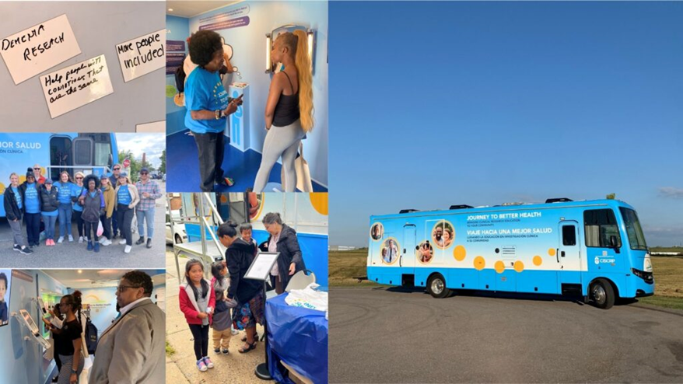
Figure 3: CISCRP mobile exhibit

Slide 25
Strengths Plain language summaries Review Panels External DEI Focus Direct community engagement Culturally competent materials | Opportunities Changing legislation in Europe requiring plain language Changing legislation in the United States requiring outreach to diverse participants Clinical trial market growth since pandemic
Weaknesses Internal DEI environment Smaller organization than similar competitors | Threats Cultural beliefs towards transparency in research in other countries Technological integration from competitors
Figure 5: CISCRP SWOT Analysis.

Slide 26
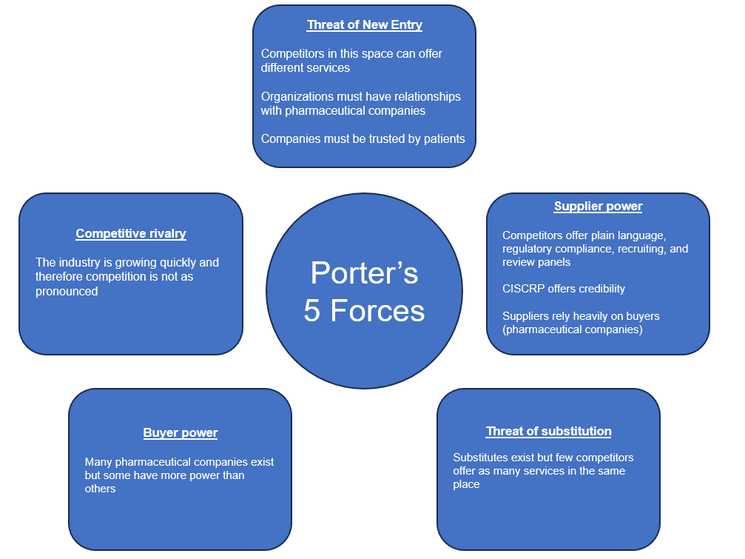
Figure 6: CISCRP Porter’s 5 Forces.

Slide 27
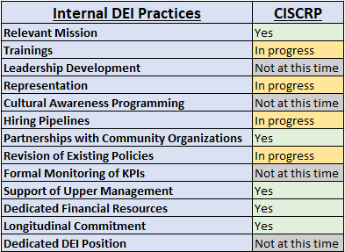
Figure 9: Comparison of valuable internal DEI practices with current CISCRP efforts

Slide 28
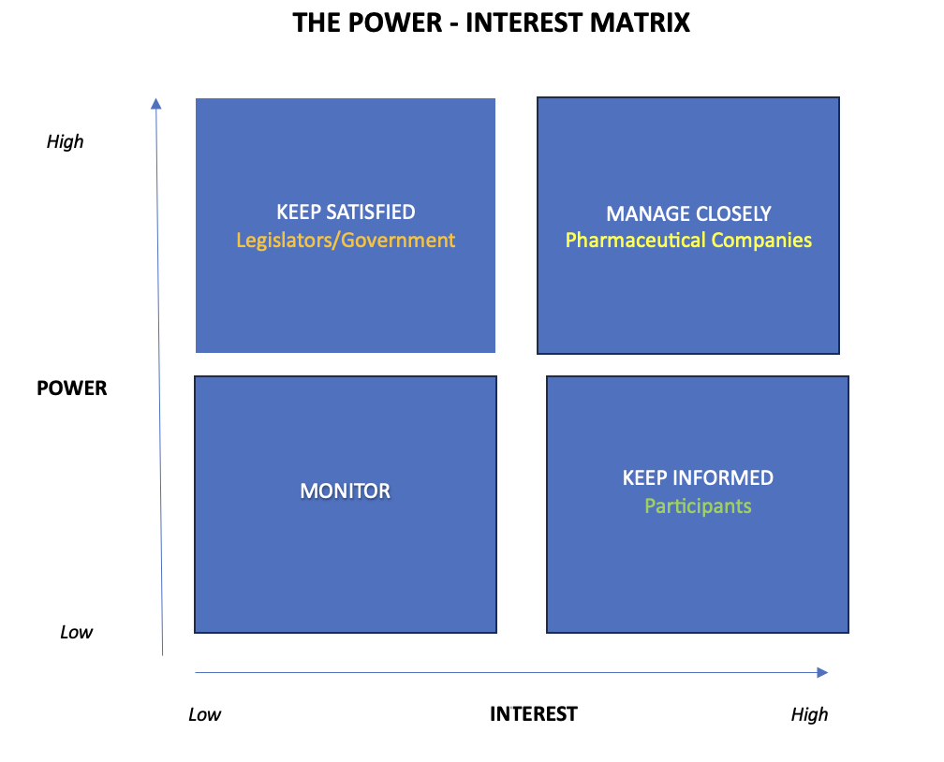
Figure 8: Stakeholder Analysis.

Slide 29
DEI and Performance
Gender diversity — The performance differential between the most and least gender-diverse organizations is 48%.
Ethnic and cultural diversity — Organizations in the top quartile of ethnic and cultural diversity, on executive teams outperform those in the bottom quartile by 36%.
Better retention - Organizations that are not focusing on creating an environment of DEI are experiencing 1.6x more voluntary turnover than those that are focused on it. (McLean & Company, 2022 HR Trends Survey; n=414)
(McKinsey, May 2020)
Notes:
https://hr.mcleanco.com/research/ss/create-a-people-first-diversity-equity-and-inclusion-strategy

Slide 30
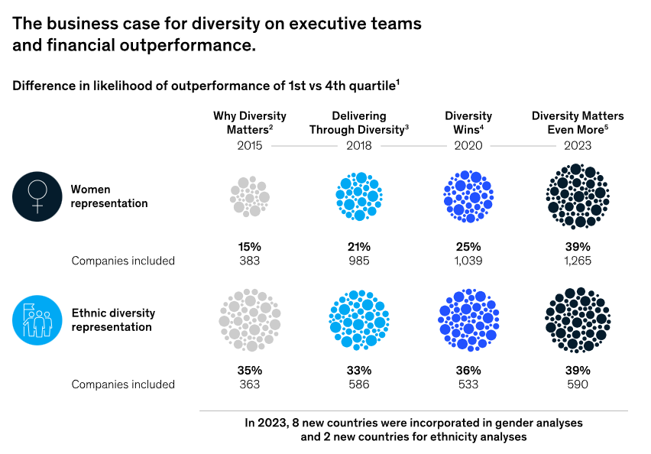
DEI and Performance
https://www.mckinsey.com/featured-insights/diversity-and-inclusion/diversity-matters-even-more-the-case-for-holistic-impact

Slide 31
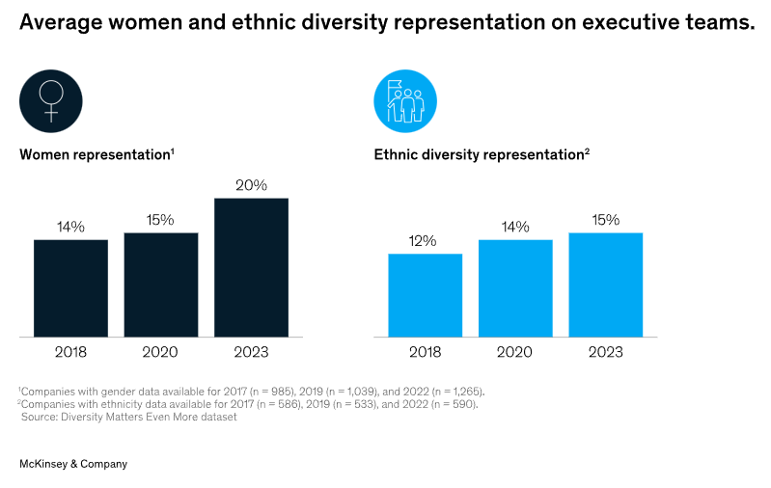
Diversity on Executive Teams
https://www.mckinsey.com/featured-insights/diversity-and-inclusion/diversity-matters-even-more-the-case-for-holistic-impact

Slide 32
Detailed Recommendations
Engage the Whole Organization in DEI Efforts
Digital Inclusivity
Virtual Team Building Activities
Remote work advocates
Expand DEI initiatives beyond the DEI committee
Develop a DEI Scorecard/dashboard
Formal monitoring system
Updated every few months
Importance of measurement
Examples: Retention rates, attrition rates, performance reviews, promotion rates, Hires and Turnover by Gender, Ethnicity or Department, Age vs Religious belief
Future potential to tie into performance review
Expand and Standardize DEI Training
Focus on leadership and management
Standardized practices
Monthly cultural programming

Slide 33
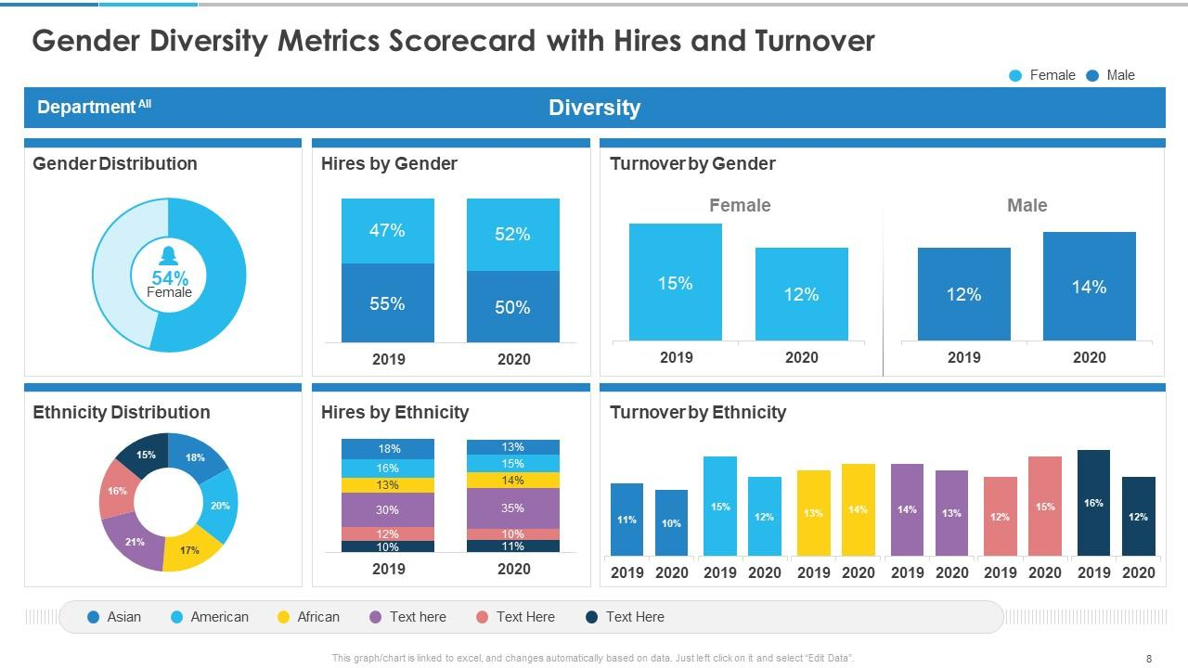
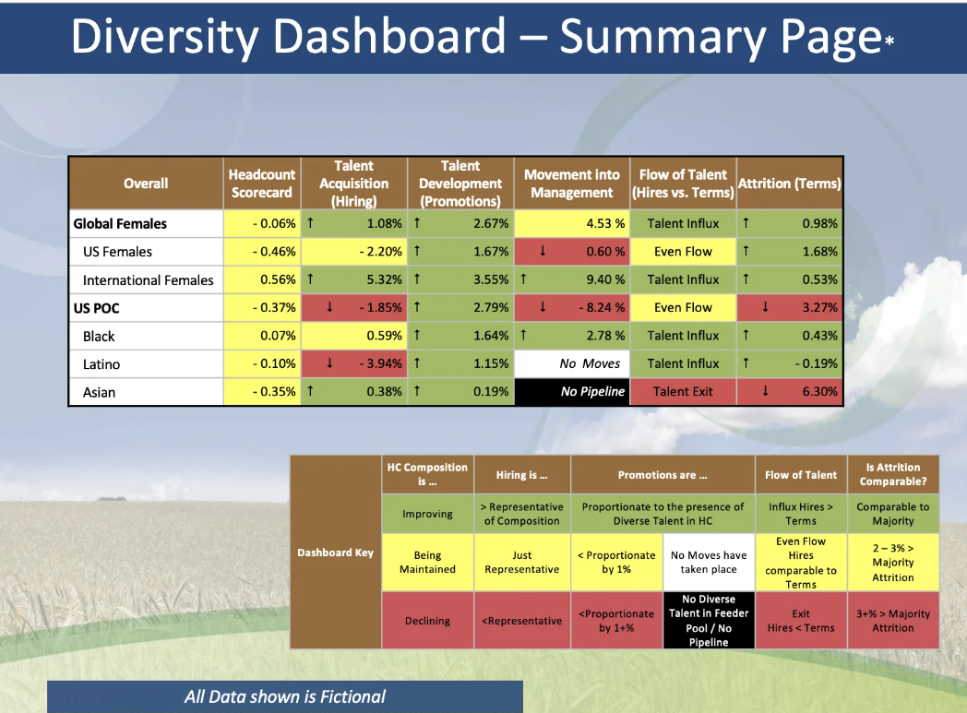
Sample DEI Scorecard/Dashboard

Slide 34
References
About Us. CISCRP. Accessed March 26, 2024. https://www.ciscrp.org/about-us/.
Services and Programs. CISCRP. Accessed March 26, 2024. https://www.ciscrp.org/services/.
Events. CISCRP. Accessed March 26, 2024. https://www.ciscrp.org/events/.
Marin N, Prajapat A, Scripps C. Interview with Corinne Scripps. Published online March 11, 2024.
DEI Lunch & Learn.
Noori R. 10 Dei strategy best practices: How to create an inclusive and equitable workplace. Nectar. Accessed March 26, 2024. https://nectarhr.com/blog/dei-strategy-best-practices.
Jourdan L. 7 metrics to measure your organization’s DEI Progress. Harvard Business Review. May 4, 2023. Accessed March 26, 2024. https://hbr.org/2023/05/7-metrics-to-measure-your-organizations-dei-progress.
Create a people-first diversity, equity, and Inclusi... McLean & Company. Accessed March 26, 2024. https://hr.mcleanco.com/research/ss/create-a-people-first-diversity-equity-and-inclusion-strategy.
Altimare J. Seven tips for building an effective DEI strategy. Forbes. March 1, 2022. Accessed March 26, 2024. https://www.forbes.com/sites/forbescommunicationscouncil/2022/03/01/seven-tips-for-building-an-effective-dei-strategy/?sh=68d2253023c8.
Clinical Trials Support Services Market Size, Share & Trends Analysis Report By Service (Clinical Trial Site Management, Patient Recruitment Management), By Phase, By Sponsor, By Region, And Segment Forecasts, 2023 - 2030. Grand View Research. Accessed March 26, 2024. https://www.grandviewresearch.com/industry-analysis/clinical-trials-support-services-market-report.
Castino B, Renners MA. MARKET RESEARCH REPORT.
Scripps C. Competitive Landscape.
Inclusion and diversity: Gilead. Gilead Sciences, Inc. Accessed April 16, 2024. https://www.gilead.com/purpose/inclusion-and-diversity.
We Embed DE&I in All We Do at CSL. CSL. Accessed April 16, 2024. https://www.csl.com/careers/diversity-equity-inclusion.
Diversity, Equity & Inclusion at Bayer. Bayer Global. August 3, 2023. Accessed April 16, 2024. https://www.bayer.com/en/commitments/diversity-equity-inclusion-at-bayer.
Patient diversity in clinical trials: Medpace. Medpace Corporate. Accessed March 26, 2024. https://www.medpace.com/cro/clinical-trial-management/diversity-in-clinical-trials/.
Home. VOZ Advisors. Accessed March 26, 2024. https://vozadvisors.com/.
Health Literacy Media. HLM. Accessed March 26, 2024. https://www.healthliteracy.media/.
We Speak Patient. Legacy Health Strategies. Accessed March 26, 2024. https://legacyhealthstrategies.com/offerings/.
Patient engagement. Lumanity. Accessed March 26, 2024. https://lumanity.com/patient-engagement/.
Journey to Better Health Mobile Exhibit. CISCRP. Accessed March 26, 2024. https://www.ciscrp.org/mobileexhibit2023/.
Marin N, Prajapat A, Lee H. Interview with DEI Leader #1. Published online April 2024.
Marin N, Prajapat A, Lee H, Khushi K. Interview with DEI Leader #2. Published online April 2024.
Lee H, Khushi K. Interview with CISCRP Employee #1. Published online April 2024.
Marin N, Prajapat A, Lee H. Interview with CISCRP Employee #2. Published online April 2024.
Marin N, Prajapat A. Interview with CISCRP Employee #3. Published online April 2024.
Marin N, Prajapat A, Khushi K. Interview with CISCRP Employee #4. Published online April 2024.
Marin N, Prajapat A. Interview with CISCRP Employee #5. Published online April 2024.
DEI Scorecard Example 1: https://www.fair360.com/scoring-your-scorecards-a-guide-to-developing-diversity-metrics%20/
DEI Scorecard Example 2: https://www.slideteam.net/diversity-metrics-and-scorecard-powerpoint-presentation-slides.html

